Slide 1
Key Management

Slide 2
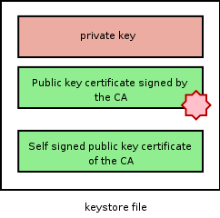
Key manipulation
JDK keytool
OpenSSL
A keystore
Private Keys
Certificates
Types
PKCS12
JKS

Slide 3


Client and service should share each other's public keys
CLIENT
SERVICE
Private key
Private key
Public key
Public key

Slide 4
Requirement
Two keystores for the service and client
Signed by a CA
Make sure you have
OpenSSL
JDK

Slide 5
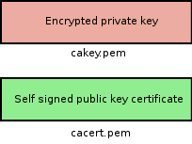
Simple Certificate Authority
$ openssl req -x509 -newkey rsa:1024 \
-keyout cakey.pem -out cacert.pem -config openssl.cnf
This creates a key pair for the CA

Slide 6
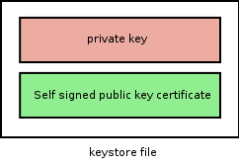
Client and Service Keys
$ keytool -genkey -alias client -keyalg RSA -keystore client.jks
$ keytool -genkey -alias service -keyalg RSA -keystore service.jks

Slide 7
Now we need our CA to sign the public keys

Slide 8
Certificate Signing Request (CSR)‏
$ keytool -certreq -keystore client.jks -storepass changeme -alias client -file client.cert.req
$ keytool -certreq -keystore service.jks -storepass changeme -alias service -file service.cert.req

Slide 9
Sign the CSRs
$ openssl ca -config openssl.cnf -out client.pem -infiles client.cert.req
$ openssl ca -config openssl.cnf -out service.pem -infiles service.cert.req
And convert the signed certificates and CA cert to DER
$ openssl x509 -outform DER -in client.pem -out client.cert
$ openssl x509 -outform DER -in service.pem -out service.cert
$ openssl x509 -outform DER -in cacert.pem -out cacert.cert

Slide 10
Import Certificates
Import CA certificate
$ keytool -import -file cacert.cert -keystore service.jks -storepass changeme -alias ca
$ keytool -import -file cacert.cert -keystore client.jks -storepass changeme -alias ca
Import signed certificates
$ keytool -import -file client.cert -keystore client.jks -storepass changeme -alias client
$ keytool -import -file service.cert -keystore service.jks -storepass changeme -alias service

Slide 11
Importing Peer Certificates
To be able to directly trust the other
$ keytool -import -file client.cert -keystore service.jks -storepass changeme -alias client
$ keytool -import -file service.cert -keystore client.jks -storepass changeme -alias service

Slide 12
Now our service and client keystores are ready!

